Slide 1
PassiveEyes
Simple, secure safety.

Slide 2
Problem
Home monitoring setups are expensive
Hardware purchasing costs?
Monthly subscription fees?
High barriers to entry

Slide 3
Solution
Use pre-existing hardware with free services
Windows 10 for hardware
Low-end phones/tables with cameras, for example
OneDrive for server
User‘s account -> free storage
Low barrier to entry
Free

Slide 4
OneDrive
Viewing
Mode
Recording
Mode

Slide 5
Demo
Prerecorded (+live?)

Slide 6
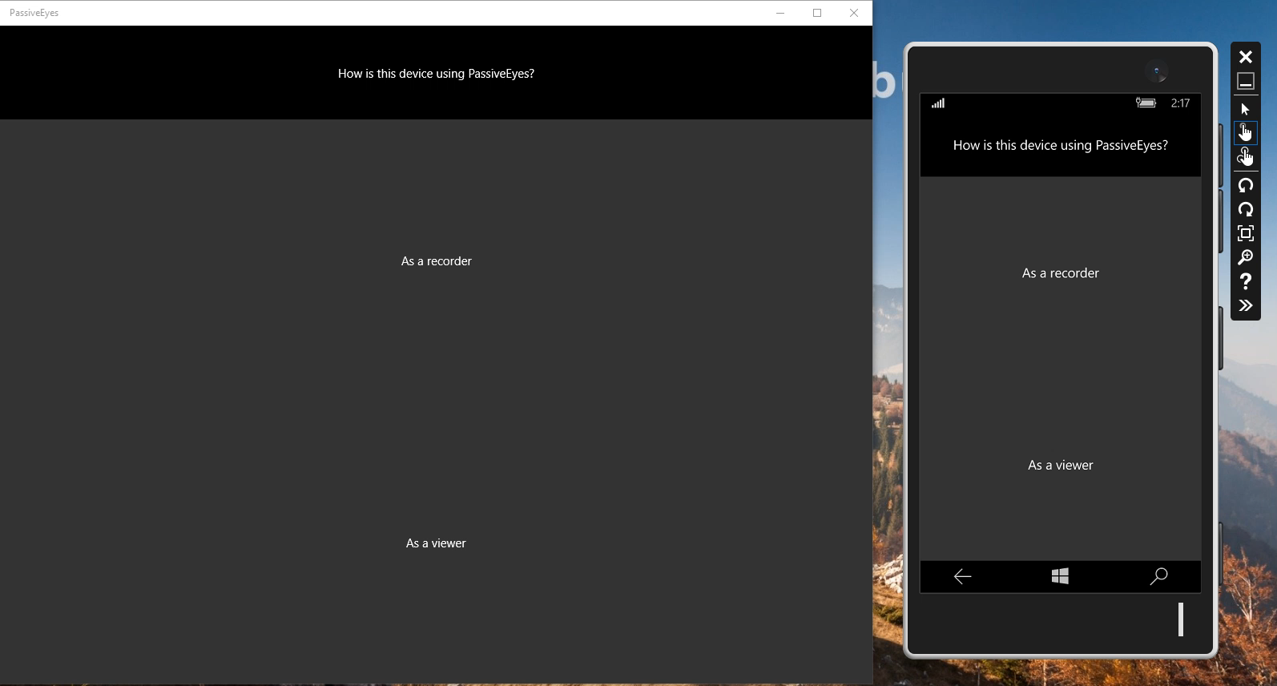

Slide 7
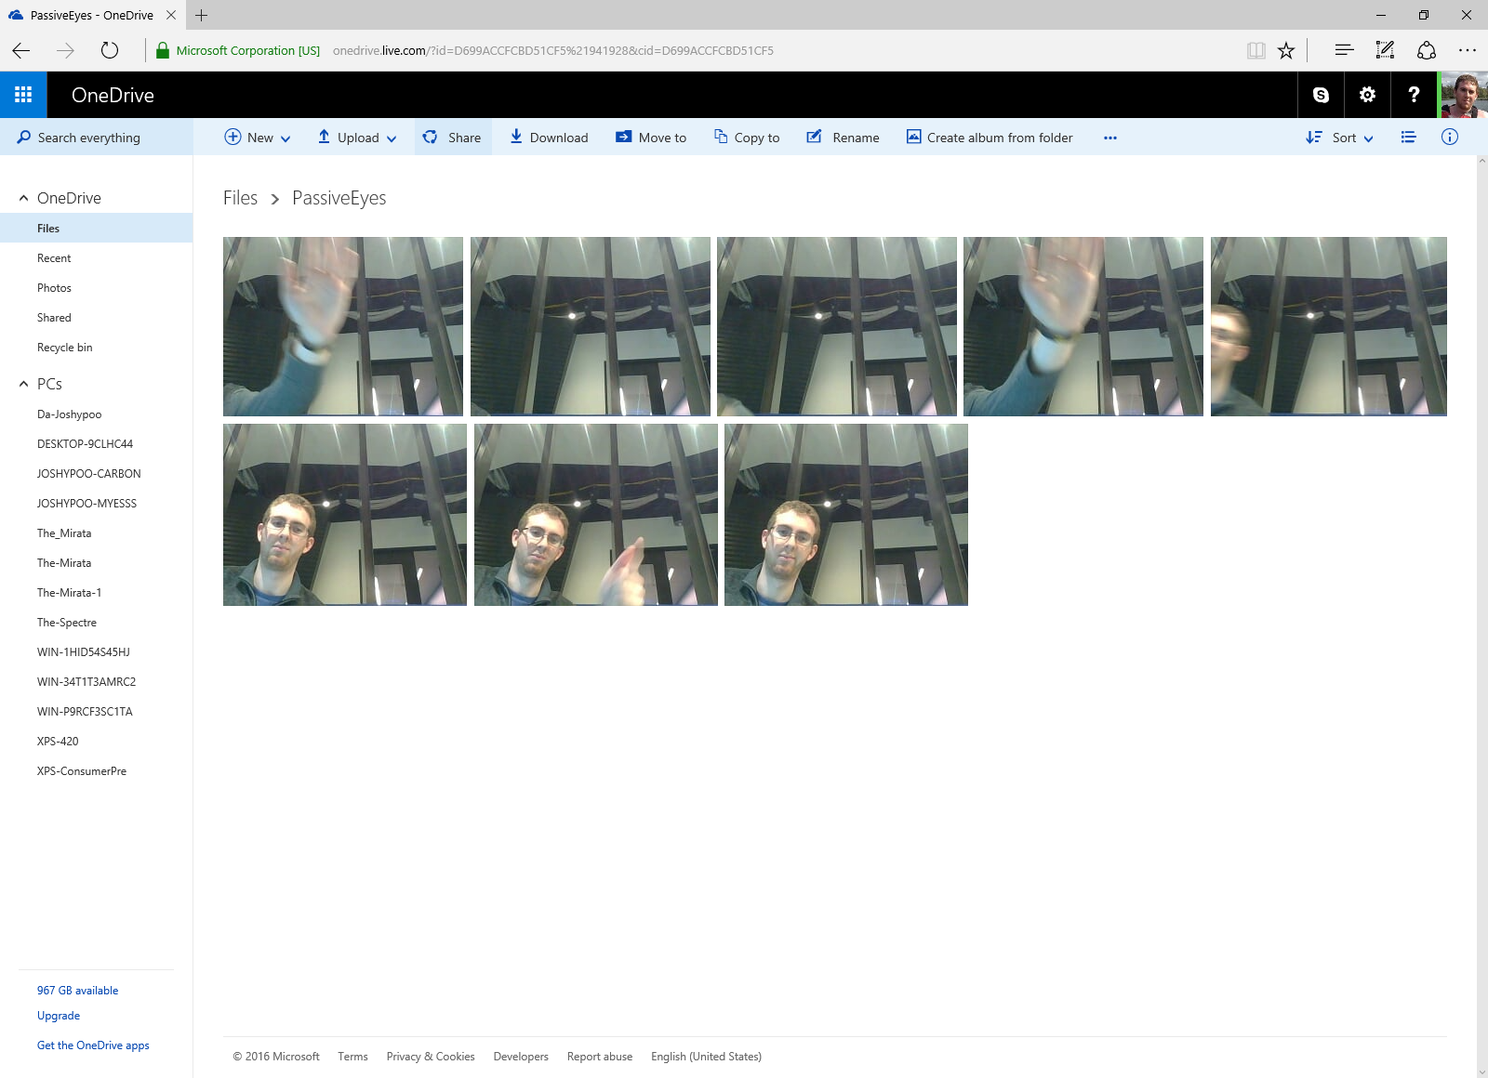

Slide 8
Empowering women (and men too)
Security
Capture images of burglaries
Monitor home
Monitoring / caregiving
Common user study requests:
Watch kids
Watch grandparents
Watch the dog

Slide 9
Gender Lens
Does it work for who we want it to?
Protip: yes!
Target audience: “Abby”
Little to no setup
No guesswork
Expands to “Tim” well
Win10 IoT capable

Slide 10
Questions
(is this awesome or what?)

